Slide 1
OneIt 무료 PPT 템플릿 #6
https://wonjc.tistory.com/

Slide 2
01
Special One
Presentation
INDEX
02
Special Two
03
Special Three
04
Special Four

Slide 3
01
02
CONTENTS
CONTENTS
Use it to describe and list various pieces of information.
Use it to describe and list various pieces of information.
03
04
CONTENTS
CONTENTS
Use it to describe and list various pieces of information.
Use it to describe and list various pieces of information.

Slide 4
A timeline for a week
DAY 1
DAY 2
DAY 3
DAY 4
DAY 5
On the first day, it is recommended to select bibimbap as the lunch menu. Because everything gets messed up.
On the first day, it is recommended to select bibimbap as the lunch menu. Because everything gets messed up.
On the first day, it is recommended to select bibimbap as the lunch menu. Because everything gets messed up.
On the first day, it is recommended to select bibimbap as the lunch menu. Because everything gets messed up.
On the first day, it is recommended to select bibimbap as the lunch menu. Because everything gets messed up.

Slide 5
Requirements for writing a report
CONTENTS
When writing a report, it is important that the introduction, body, and conclusion be clearly written.
Part I
Part II
CONTENTS
It is important not to write too long a sentence, and it is important that the ending of the sentence is clear.

Slide 6
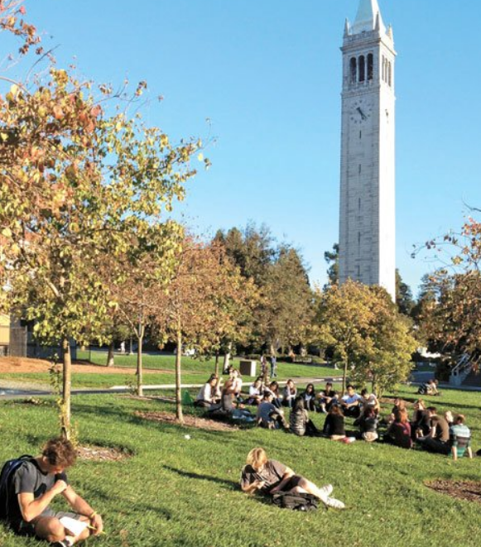
Dream big.
You can be anything
Your time is precious.
Don't just sit at your desk and study at university. Enjoy the university campus, socialize with your classmates, communicate and learn. Always have a big dream and devote yourself with a bright mind. you can do it!

Slide 7
Explore the world.
It will be a great gift for you.

Slide 8
Thank you.

