Slide 1
ONE IT FREE PPT #13
https://wonjc.tistory.com

Slide 2
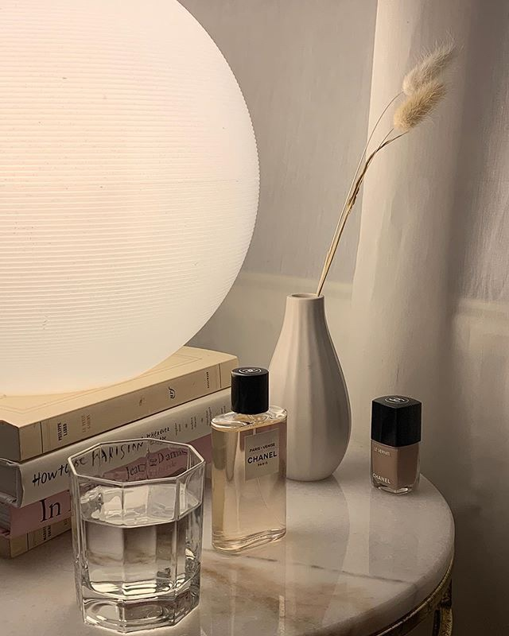
Everything is temporary. Emotions, thoughts, people, and scenery. Do not become attached, just flow with it.
If you can concentrate always on the present, you will be a happy man. Happiness is the art of never holding in your mind the memory of any unpleasant thing that has passed.

Slide 3
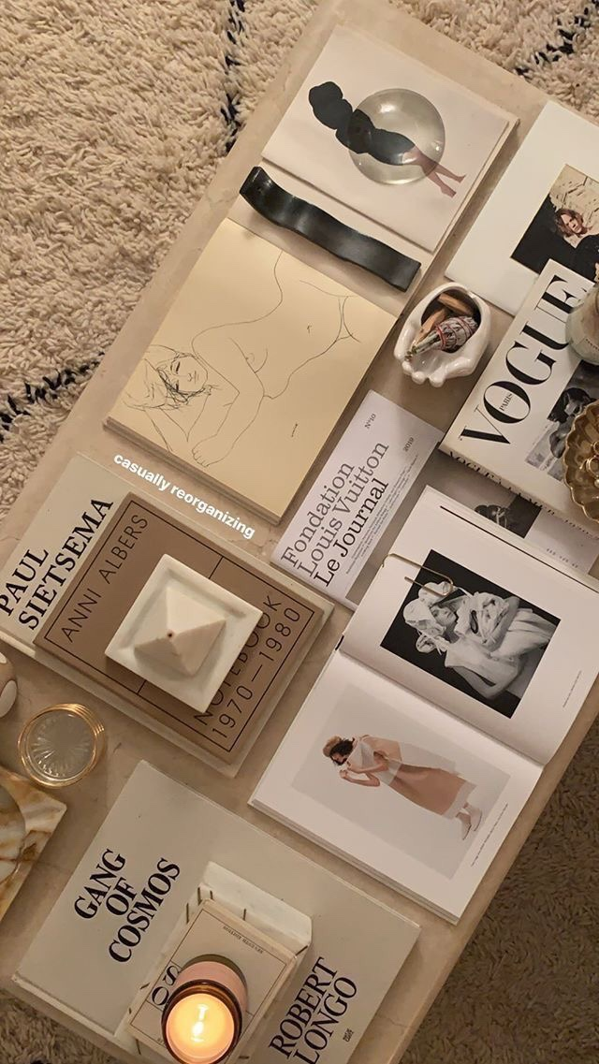
What fascinates me is that hardly anyone is wondering what we are doing on this planet. Most accepted the work – eat – entertainment – sleep cycle as life and have no desire for a deeper understanding of our purpose in this universe.

Slide 4
When you allow a thought of doubt to enter your mind, the law of attraction will soon line up one doubtful thought after another. The moment a thought of doubt comes, release it immediately. Send that thought on its way. Replace it with ”I know I am receiving now.” And feel it.

Slide 5
BE thankful for everybody in your life..
If you look at what you have in life, you will always have more. If you look at what you don’t have in life, you will never have enough.
Trying harder makes the resistance more. It’s letting go of the oars that makes it less. It’s trusting the process. It’s trusting the stream. It’s trusting that you have an inner being that is calling you toward it.

Slide 6
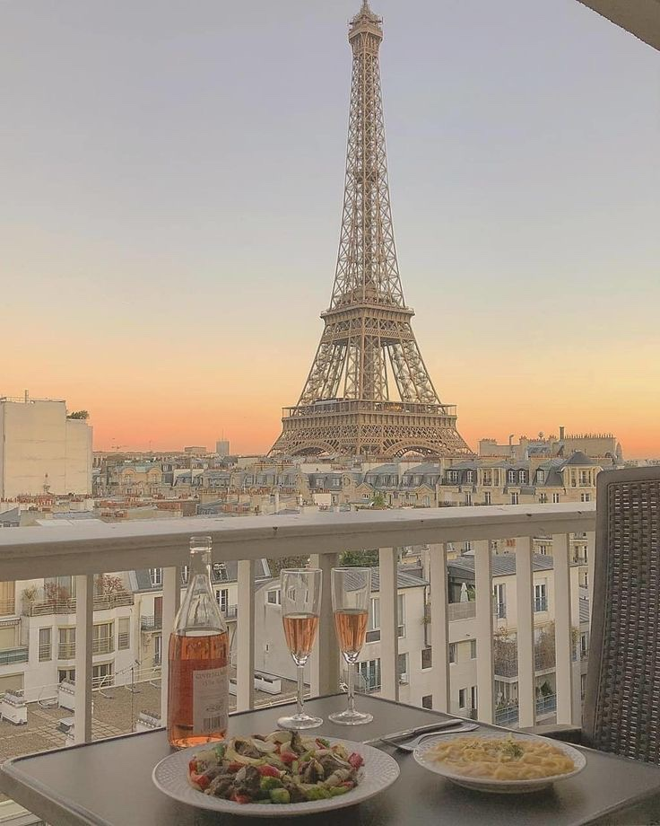
We are all storytellers. We all live on a network of stories. There isn’t a stronger connection between people than storytelling.

Slide 7
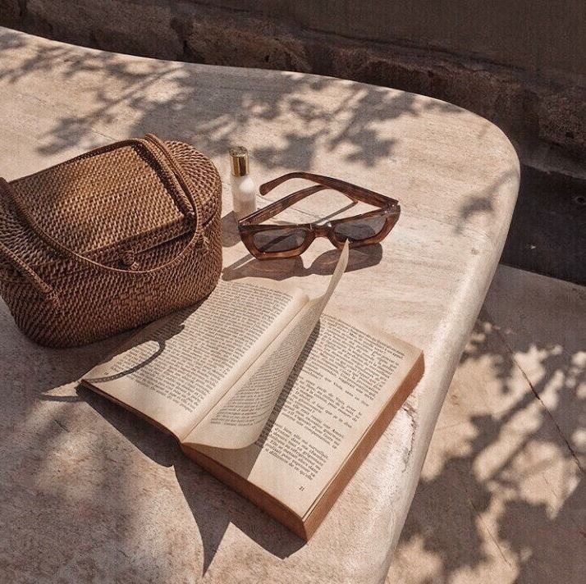
Being to use the two most powerful words, I am, to your advantage, how about. I am receiving every good thing. I am happy. I am abundant. I am healthy. I am loved. I am always on time. I am eternal youth. I am filled with energy every single day.

Slide 8
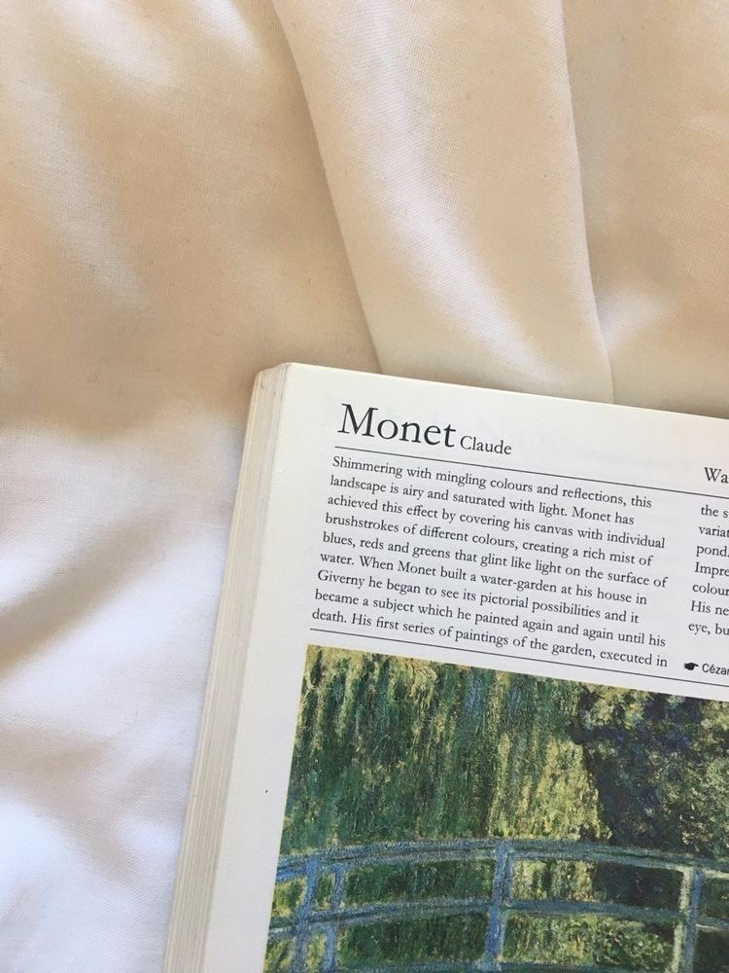
You fall, you rise, you make mistakes, you live, you learn. You are human, not perfect. You’ve been hurt, but you’re alive. Think of what a precious privilege it is to be alive- to breathe, to think, to enjoy, and to chase the things you love. Sometimes there is sadness in our journey, but there is also lots of beauty. We must keep putting one foot in front of the other even when we hurt, for we will never know what is waiting for us just around the bend.

Slide 9
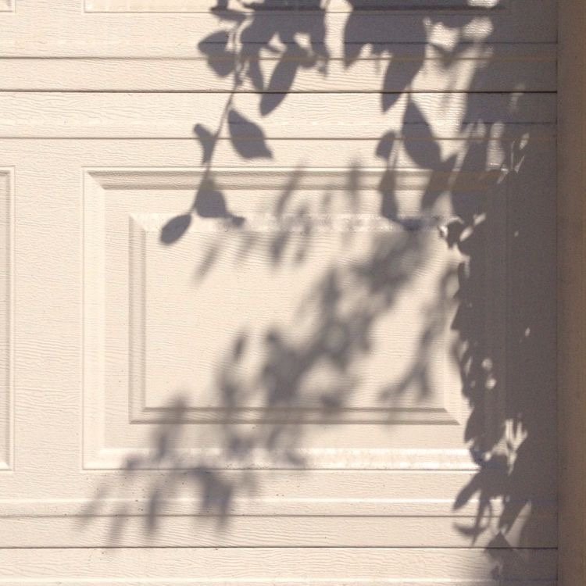
All of us to understand the importance of branding. We are CEOs of our own companies: Me Inc. To be on business today, our most important job is to be head marketer for the brand called you.

Slide 10
THANK YOU : )

