Slide 1
Real.PPT FREE TEMPLATE #30
https://pptfree.wonjc.com

Slide 2
Part 1
You can concentrate always on the present.
Part 2
We are all storytellers
Part 3
We all live on a network of stories
Part 4
There isn’t a stronger connection between people than storytelling.

Slide 3
Permission
If your stories are all about your products and services, that’s not storytelling. It’s a brochure. Give yourself permission to make the story bigger.

Slide 4
Everything is temporary.
When you truly want something and go after it without limiting yourself with disbelief, the universe will make it happen.
Everything is temporary. Emotions, thoughts, people, and scenery.
Everything is temporary. Emotions, thoughts, people, and scenery. Do not become attached, just flow with it.
All of us to understand the importance of branding. We are CEOs of our own companies: Me Inc. To be on business today, our most important job is to be head marketer for the brand called you.
Forgive yourself for not knowing what you didn’t know until you lived through it
Honor your path. Trust your journey. Learn, grow, evolve, become.

Slide 5
You just need to trust that what you want is coming and watch how fast it comes.
Everything you want is coming. Relax and let the universe pick the timing and the way. You just need to trust that what you want is coming and watch how fast it comes.
Everything you want is coming. Relax and let the universe pick the timing and the way
All of us to understand the importance of branding. We are CEOs of our own companies: Me Inc. To be on business today, our most important job is to be head marketer for the brand called you.
Send that thought on its way. Replace it with ”I know I am receiving now.” And feel it.

Slide 6
Happy
If you can concentrate always on the present, you will be a happy man. Happiness is the art of never holding in your mind the memory of any unpleasant thing that has passed.
We are all storytellers. We all live on a network of stories. There isn’t a stronger connection between people than storytelling.

Slide 7
I am happy
Being to use the two most powerful words, I am, to your advantage, how about. I am receiving every good thing. I am happy. I am abundant. I am healthy. I am loved. I am always on time. I am eternal youth. I am filled with energy every single day.

Slide 8
Send that thought on its way. Replace it with ”I know I am receiving now.” And feel it.
When you truly want something and go after it without limiting yourself with disbelief, the universe will make it happen.
Forgive yourself for not knowing what you didn’t know until you lived through it. Honor your path. Trust your journey. Learn, grow, evolve, become.
When you allow a thought of doubt to enter your mind, the law of attraction will soon line up one doubtful thought after another. The moment a thought of doubt comes, release it immediately.

Slide 9
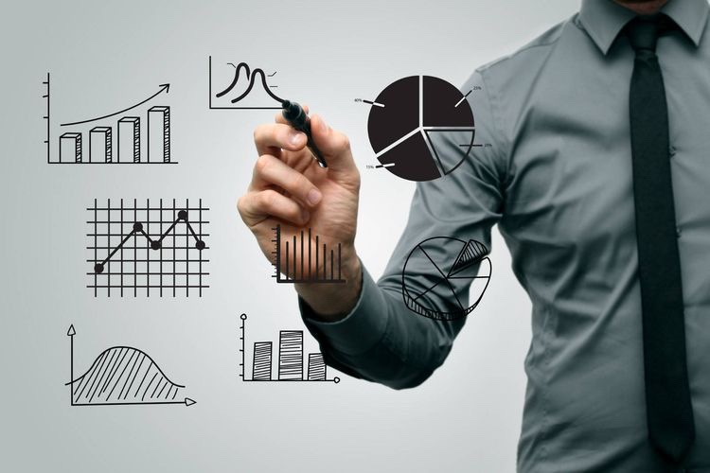
What fascinates me is that hardly anyone is wondering what we are doing on this planet. Most accepted the work – eat – entertainment – sleep cycle as life and have no desire for a deeper understanding of our purpose in this universe.
Being to use the two most powerful words, I am, to your advantage, how about. I am receiving every good thing. I am happy. I am abundant. I am healthy. I am loved. I am always on time. I am eternal youth. I am filled with energy every single day.

Slide 10
THANK YOU ☺

