Slide 1
Real.PPT FREE TEMPLATE #33
https://pptfree.wonjc.com

Slide 2
Stay alive.
I know you are sad, so I won’t tell you to have a good day. Stay alive. Feed yourself well. Wear comfortable clothes and don’t give up yourself just yet. It will get better. Until then, have a day.

Slide 3
Trying harder makes the resistance more. It’s letting go of the oars that makes it less. It’s trusting the process. It’s trusting the stream. It’s trusting that you have an inner being that is calling you toward it.

Slide 4
I know you are sad, so I won’t tell you to have a good day. Stay alive. Feed yourself well. Wear comfortable clothes and don’t give up yourself just yet. It will get better. Until then, have a day.

Slide 5
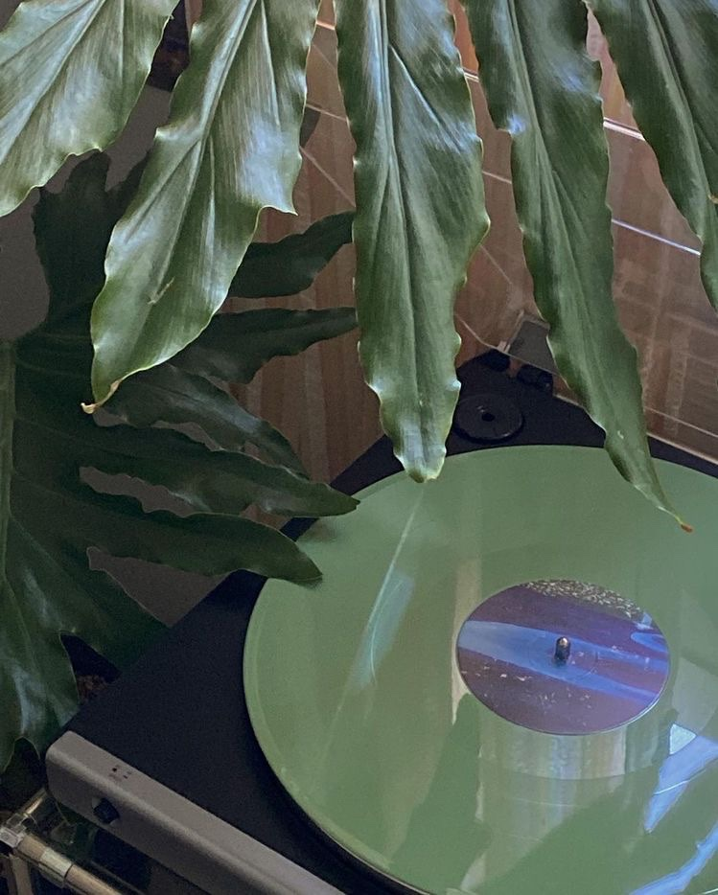
Everything you want is coming
Everything you want is coming. Relax and let the universe pick the timing and the way. You just need to trust that what you want is coming and watch how fast it comes.

Slide 6
Forgive yourself for not knowing what you didn’t know until you lived through it. Honor your path. Trust your journey. Learn, grow, evolve, become.
When you allow a thought of doubt to enter your mind, the law of attraction will soon line up one doubtful thought after another. The moment a thought of doubt comes, release it immediately. Send that thought on its way. Replace it with ”I know I am receiving now.” And feel it.

Slide 7
Trying harder makes the resistance more. It’s letting go of the oars that makes it less. It’s trusting the process. It’s trusting the stream. It’s trusting that you have an inner being that is calling you toward it.

Slide 8
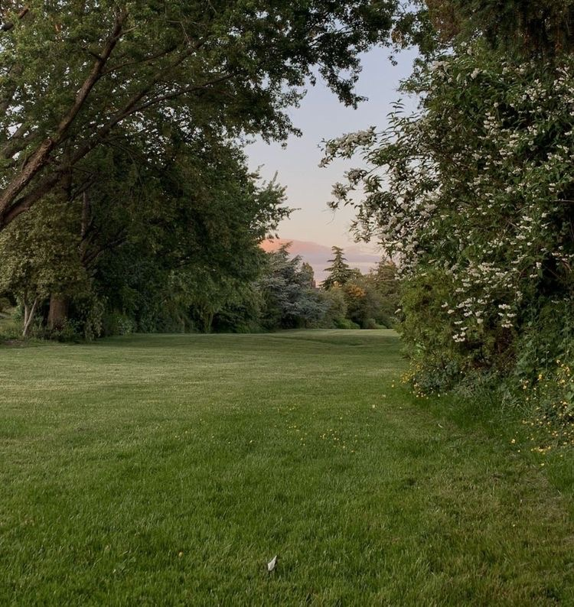
Thought
When you allow a thought of doubt to enter your mind, the law of attraction will soon line up one doubtful thought after another. The moment a thought of doubt comes, release it immediately. Send that thought on its way. Replace it with ”I know I am receiving now.” And feel it.

Slide 9
You fall, you rise, you make mistakes, you live, you learn. You are human, not perfect. You’ve been hurt, but you’re alive. Think of what a precious privilege it is to be alive- to breathe, to think, to enjoy, and to chase the things you love. Sometimes there is sadness in our journey, but there is also lots of beauty. We must keep putting one foot in front of the other even when we hurt, for we will never know what is waiting for us just around the bend.

Slide 10
THANK YOU ☺

