Slide 1
Real.PPT FREE TEMPLATE #35
https://pptfree.wonjc.com

Slide 2
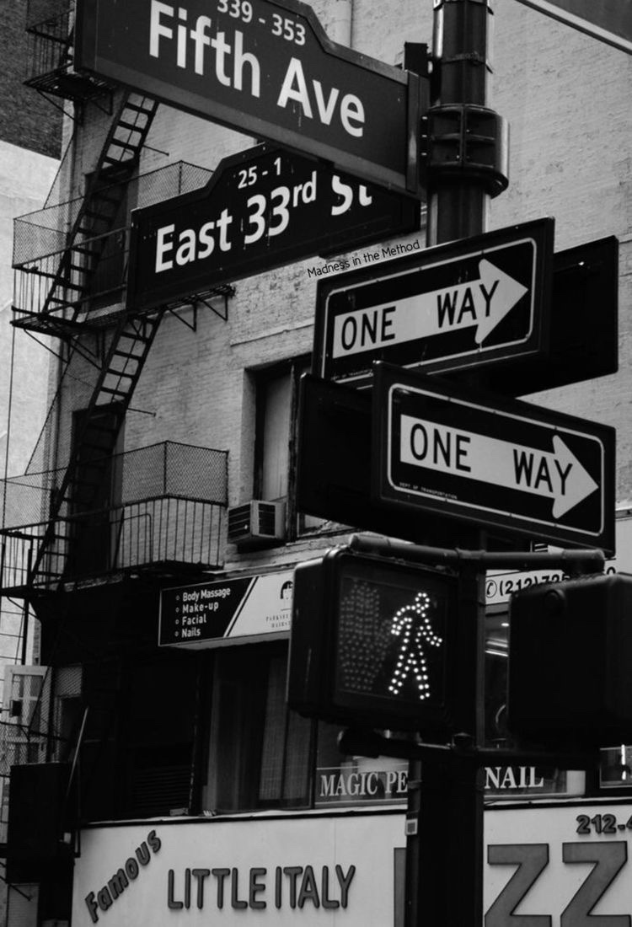
Trying harder makes the resistance more. It’s letting go of the oars that makes it less. It’s trusting the process. It’s trusting the stream. It’s trusting that you have an inner being that is calling you toward it.

Slide 3
When you allow a thought of doubt to enter your mind, the law of attraction will soon line up one doubtful thought after another. The moment a thought of doubt comes, release it immediately. Send that thought on its way. Replace it with ”I know I am receiving now.” And feel it.

Slide 4
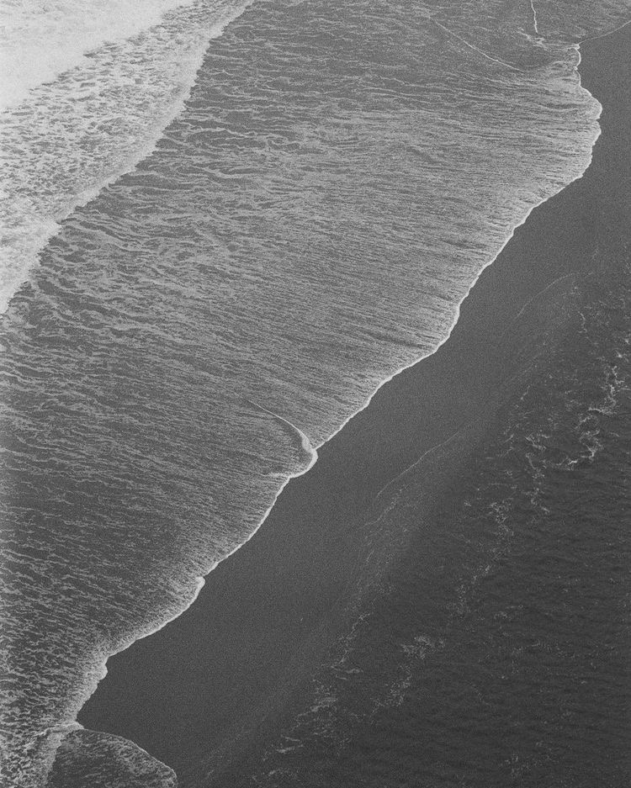
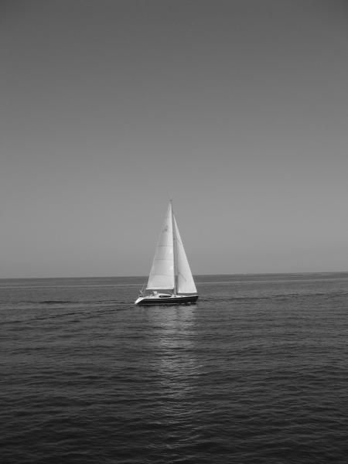
Being to use the two most powerful words, I am, to your advantage, how about. I am receiving every good thing. I am happy. I am abundant. I am healthy. I am loved. I am always on time. I am eternal youth. I am filled with energy every single day.
You just need to trust that what you want is coming and watch how fast it comes.

Slide 5
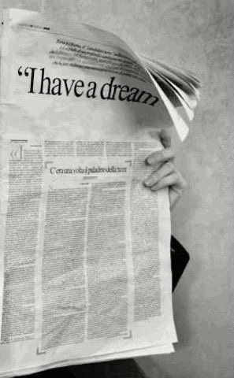
You fall, you rise, you make mistakes, you live, you learn. You are human, not perfect. You’ve been hurt, but you’re alive. Think of what a precious privilege it is to be alive- to breathe, to think, to enjoy, and to chase the things you love. Sometimes there is sadness in our journey, but there is also lots of beauty. We must keep putting one foot in front of the other even when we hurt, for we will never know what is waiting for us just around the bend.

Slide 6
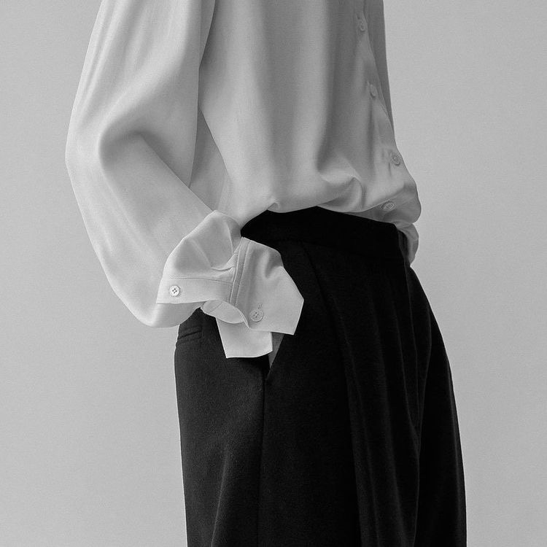
What fascinates me is that hardly anyone is wondering what we are doing on this planet. Most accepted the work – eat – entertainment – sleep cycle as life and have no desire for a deeper understanding of our purpose in this universe.

Slide 7
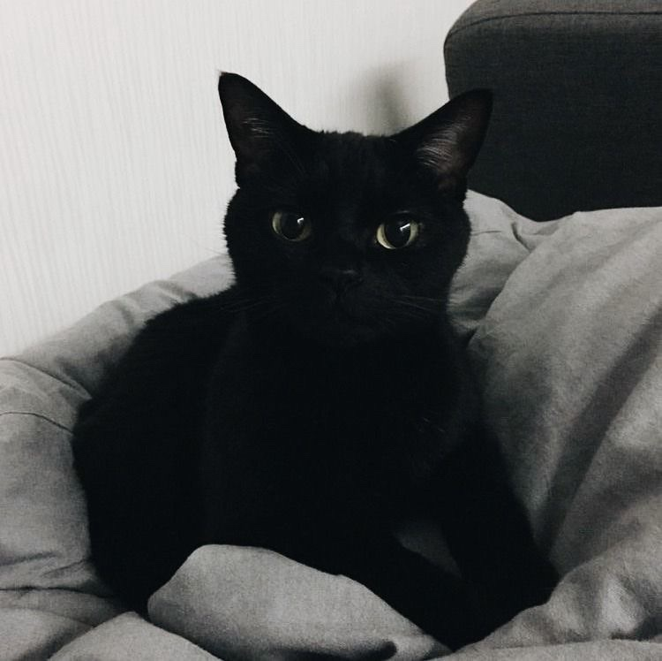
It’s trusting that you have an inner being that is calling you toward it.

Slide 8
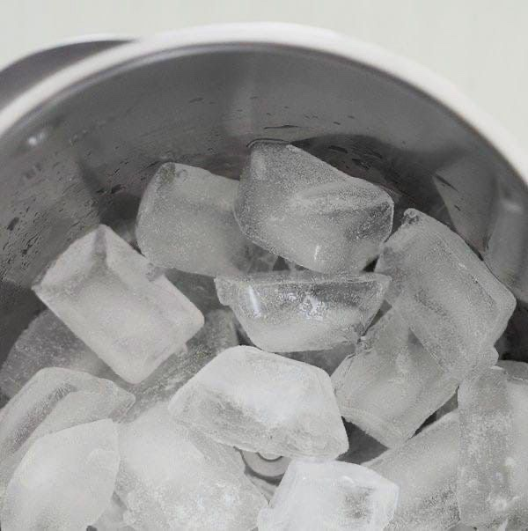
Everything you want is coming. Relax and let the universe pick the timing and the way. You just need to trust that what you want is coming and watch how fast it comes.

Slide 9
Being to use the two most powerful words, I am, to your advantage, how about. I am receiving every good thing. I am happy. I am abundant. I am healthy. I am loved. I am always on time. I am eternal youth. I am filled with energy every single day.

Slide 10
THANK YOU ☺

