Slide 1
Real.PPT FREE TEMPLATE #61
https://pptfree.wonjc.com

Slide 2
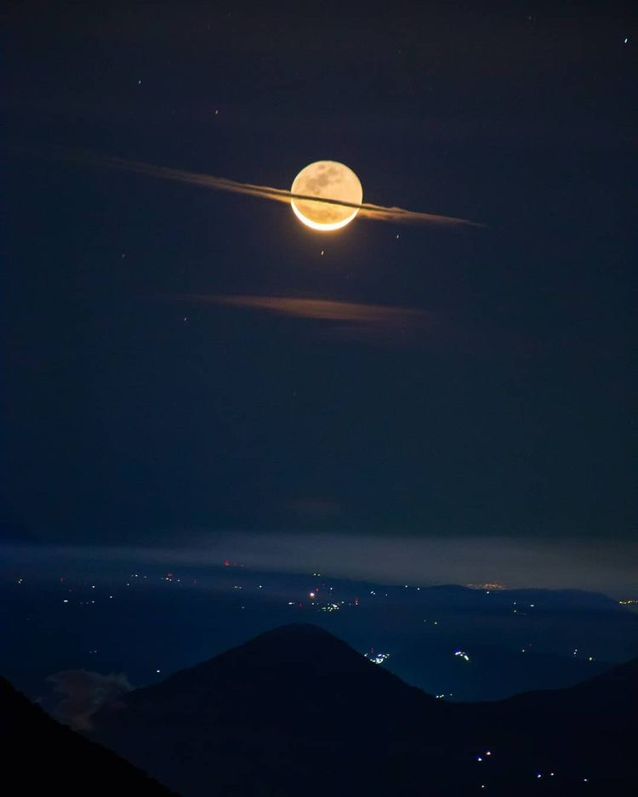
When you truly want something and go after it without limiting yourself with disbelief, the universe will make it happen.
they proclaim it can’t be done. I deem that the very best time to make the effort.
Send that thought on its way. Replace it with ”I know I am receiving now.” And feel it.

Slide 3
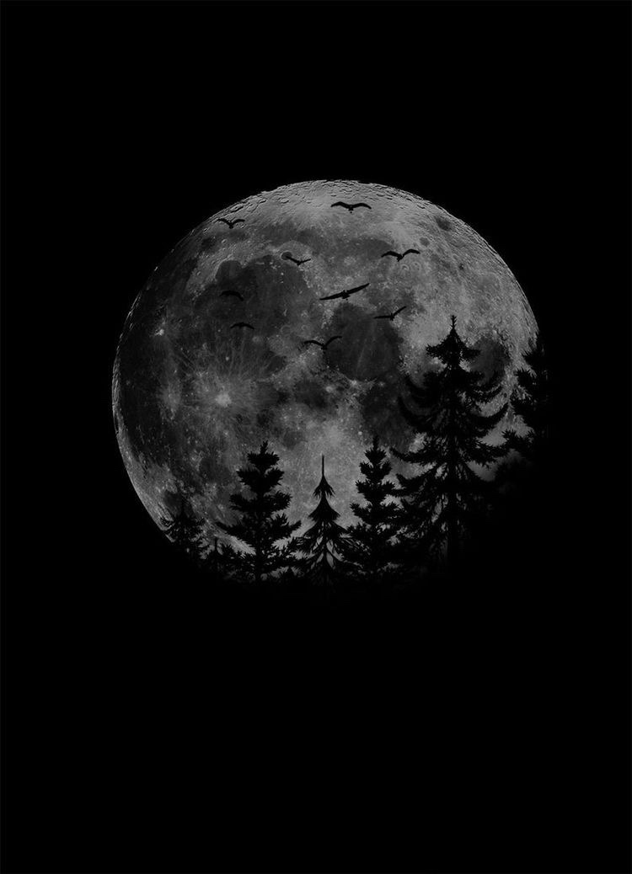
It’s trusting the stream. It’s trusting that you have an inner being that is calling you toward it.

Slide 4
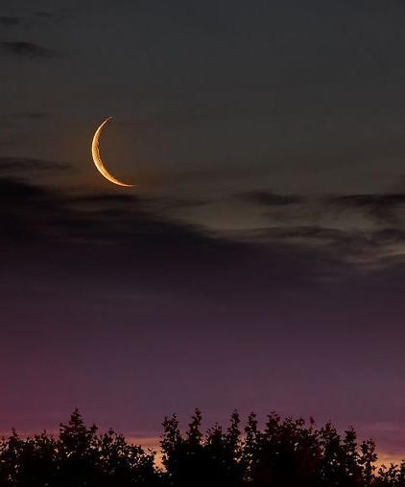
The secret of getting ahead is getting started.
The secret of getting started is breaking your complex overwhelming tasks into small manageable tasks, and then starting on the first one.

Slide 5
If your stories are all about your products and services, that’s not storytelling.

Slide 6
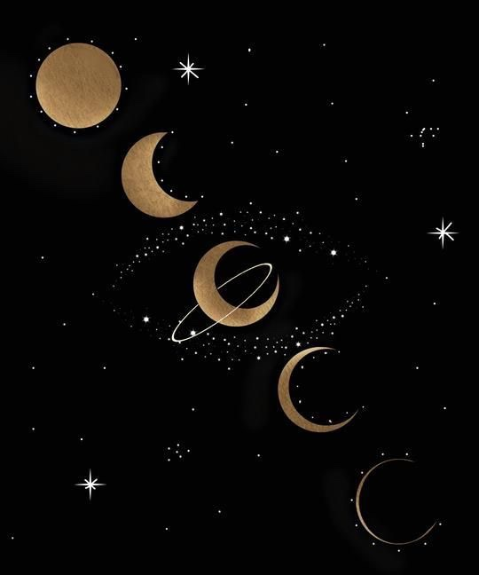
If you can concentrate always on the present, you will be a happy man. Happiness is the art of never holding in your mind the memory of any unpleasant thing that has passed.

Slide 7
Trying harder makes the resistance more. It’s letting go of the oars that makes it less. It’s trusting the process. It’s trusting the stream. It’s trusting that you have an inner being that is calling you toward it.

Slide 8
THANK YOU ☺

