Slide 1
Real.PPT FREE TEMPLATE #118
https://pptfree.wonjc.com

Slide 2
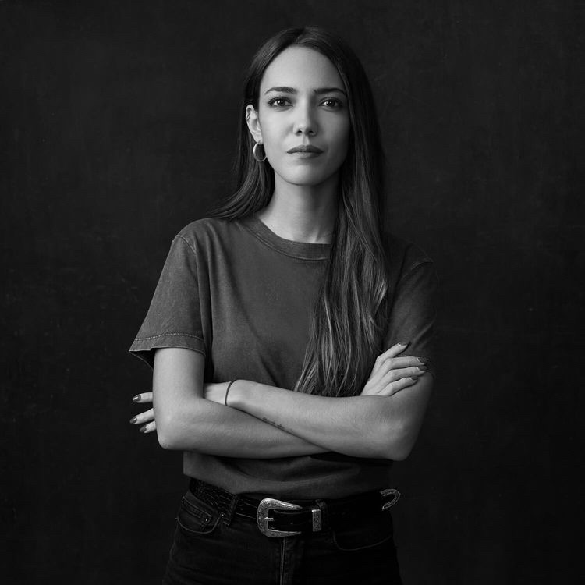
WELCOME !
Everything you want is coming
Everything you want is coming. Relax and let the universe pick the timing and the way. You just need to trust that what you want is coming and watch how fast it comes.

Slide 3
We are all storytellers. We all live on a network of stories. There isn’t a stronger connection between people than storytelling.
Happy
Listen to your dreams. Follow your heart. Do what you love. Enjoy life. And expect miracles.
If you can concentrate always on the present, you will be a happy man. Happiness is the art of never holding in your mind the memory of any unpleasant thing that has passed.
For every challenge encountered there is an opportunity for growth.

Slide 4
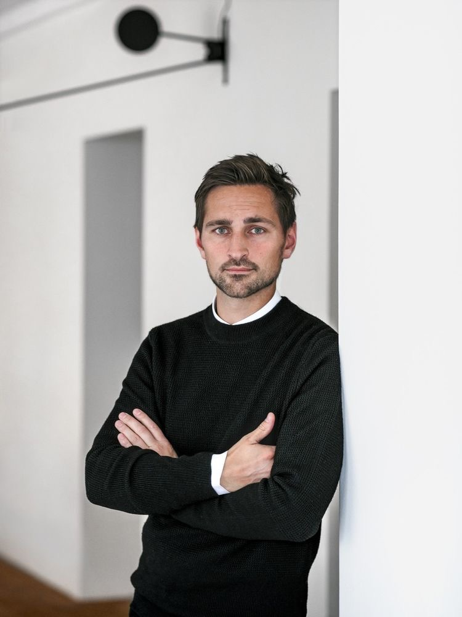
It is a new day, fresh start, fresh energy, new opportunities. Get your mind right, be thankful, be positive and start your day right.
This is my life, my story, my book. I will no longer let anyone else write; Nor will I apologize for the edits I make.

Slide 5
Be honest when in trouble and simple when in wealth.
Good or bad past or present they all made you the person that you are today.
You are human, not perfect
Sometimes there is sadness in our journey
there is also lots of beauty.
You fall, you rise, you make mistakes, you live, you learn.
You’ve been hurt, but you’re alive.

Slide 6
Listen to your dreams. Follow your heart.
Life is like a book. Some chapters are sad, some are happy, and some are exciting, but if you never turn the page, you will never know what the next chapter has in store for you.

Slide 7
I am filled with energy every single day.
This is called the life management
Do what you love. Enjoy life. And expect miracles.
Being to use the two most powerful words, I am, to your advantage, how about. I am receiving every good thing. I am happy. I am abundant. I am healthy. I am loved. I am always on time. I am eternal youth. I am filled with energy every single day.
Be polite when in authority and be silent when in anger.
Good or bad past or present they all made you the person that you are today.

Slide 8
THANK YOU ☺

